Slide 1
PL/SQL - Cursor
Unit-5

Slide 2
PL/SQL Data Types and Constants
%TYPE: This attribute provides integration. PL/SQL block can use this to declare variables based on definition of columns in the table.
If the column’s attribute change, the variable’s attribute change as well.
NOT NULL: Causes creation of a variable or constant that cannot be assigned a null value. If the attempt is made to assign NULL, SL/SL engine will through an internal exception
CONSTANT: RAW -> it is used to store binary data
RowID -> This datatype is same as DB pseudo-column type, it hold a row id which is unique for every row in the table
LOB Types:
BLOB-> Stores Unstructured binary data upto 4 GB, can contain video or picture information
CLOB-> Stores single byte Characters upto 4GB in length, used to store documents
BFILE-> Stores a pointer to readonly birary data stored as an external file outside the DB

Slide 3
A CURSOR
A cursor is a temporary work area created in the system memory when a SQL statement is executed. A cursor contains information on a select statement and the rows of data accessed by it. This temporary work area is used to store the data retrieved from the database, and manipulate this data.
It is Allocated by Database Server at the Time of Performing DML(Data Manipulation Language) operations on Table by User. Cursors are used to store Database Tables.
There are 2 types of Cursors: Implicit Cursors, and Explicit Cursors.

Slide 4
Implicit Cursors:
Implicit Cursors are also known as Default Cursors of SQL SERVER. These Cursors are allocated by SQL SERVER when the user performs DML operations.
Explicit Cursors:
Explicit Cursors are Created by Users whenever the user requires them. Explicit Cursors are used for Fetching data from Table in Row-By-Row Manner.

Slide 5
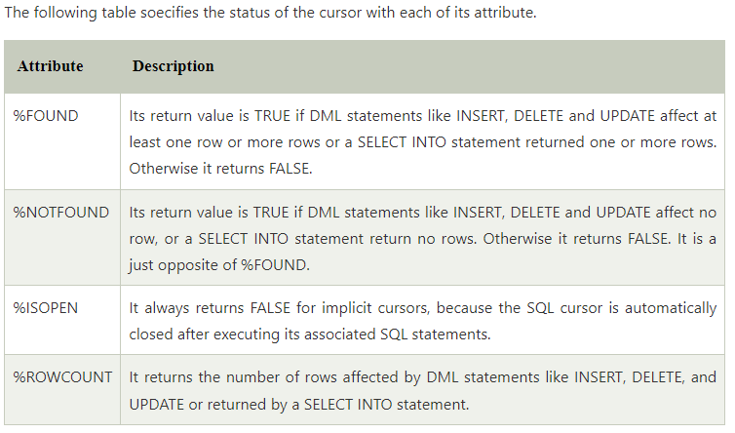

Slide 6
Example of Implicit Cursor
DECLARE
total_rows number(2);
BEGIN
UPDATE customers
SET salary = salary + 5000;
IF sql%notfound THEN
dbms_output.put_line('no customers updated');
ELSIF sql%found THEN
total_rows := sql%rowcount;
dbms_output.put_line( total_rows || ' customers updated ');
END IF;
END;
/

Slide 7
Explicit Cursors
Explicit cursors are programmer-defined cursors for gaining more control over the context area. An explicit cursor should be defined in the declaration section of the PL/SQL Block. It is created on a SELECT Statement which returns more than one row.
The syntax for creating an explicit cursor is −
CURSOR cursor_name IS select_statement;
Working with an explicit cursor includes the following steps −
Declaring the cursor for initializing the memory
Opening the cursor for allocating the memory
Fetching the cursor for retrieving the data
Closing the cursor to release the allocated memory

Slide 8
Example
DECLARE
c_id customers.id%type;
c_name customers.name%type;
c_addr customers.address%type;
CURSOR c_customers is
SELECT id, name, address FROM customers;
BEGIN
OPEN c_customers;
LOOP
FETCH c_customers into c_id, c_name, c_addr;
EXIT WHEN c_customers%notfound;
dbms_output.put_line(c_id || ' ' || c_name || ' ' || c_addr);
END LOOP;
CLOSE c_customers;
END;
/

Slide 9
Cursor For Loop :
Oracle provides another loop-statements to control loops specifically for cursors.
This statements is a variation of the basic FOR loop , and it is known as cursor for loops.
Syntax:
FOR VARIABLE IN CURSORNAME
LOOP
<EXECUTE COMMANDS>
END LOOP

Slide 10
Parameterized Cursors
Oracle allows to pass parameters to cursors that can be used to provide condition with WHERE clause. If parameters are passed to cursor, that cursor is called a parameterized cursors.
Syntax:
CURSOR CURSORNAME (VARIABLENAME DATATYPES ) IS SELECT.........
And, parameters can be passed to cursor while opening it using syntax-
Syntax:
OPEN CURSORNAME (VALUE / VARIABLE / EXPRESSION );

Slide 11
Cursor Within Cursor

